Slide 1

English Communication
Pre-Intermediate

Slide 2

Instructor: David Connors
Website: esldocs.com/inha
Office: 1212
Admin. Office: 1306
Admin. Phone: 032-860-9254

Slide 3

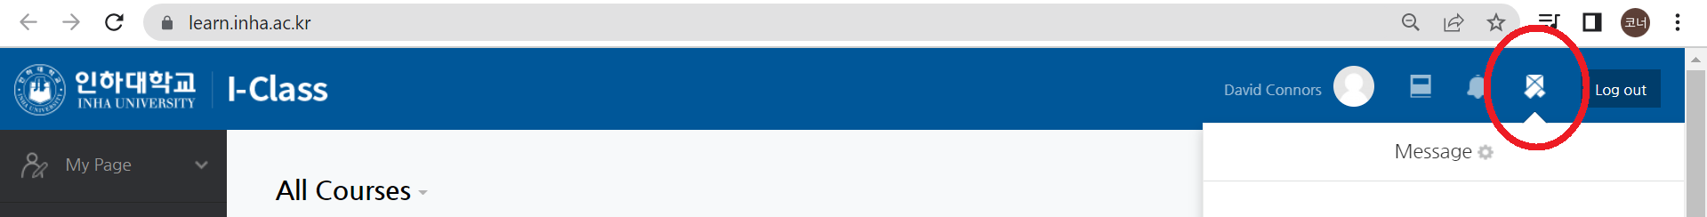
Contact:
i-class message
office #1212 – by appointment
Please include in your i-class message:
name eg: Kim Yuna
student number 12221234
Class EC 24
*Please don’t send the same message to both i-class and my email.

Slide 4



Text:
Unlock 2
Listening & Speaking Skills
INHA bookstore:
010-6251-4376

Slide 5
Grading:
Attendance 10%
Participation 5%
Homework 10%
Quizzes 25%
Midterm Exam 25%
Final Exam 25%

Slide 6

Grading:
Maximum allowance:
A
B
C-F
25%
35%
40%
B
> 70%
C
55% -70%
D
< 55%
F
< 40%
8 absences
* +s and 0s will be used.

Slide 7
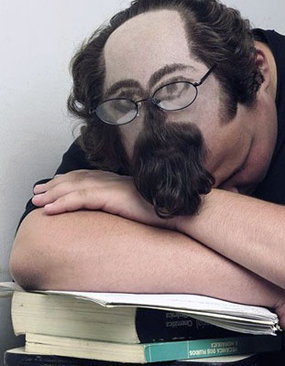
Attendance – 10%
Absent 8 classes = F
Excuses: military
covid-19
Other excuse? Talk to me.

Slide 8

Participation – 5%
You may lose participation points if:
- you’re not speaking English
- you’re not doing the activities

Slide 9

Quizzes – 25%
3 quizzes
Multiple choice,
matching, T or F,
fill in the blank, etc.
(no essays)
Don’t miss a quiz!

Slide 10

Homework – 10%
Online homework:
cambridgeone.org
Progress + Score
(% completion) + (% correct answers)
To register you need to:
- get a book with an unscratched code.
- get a class code.
-use your STUDENT NUMBER as your LAST NAME

Slide 11
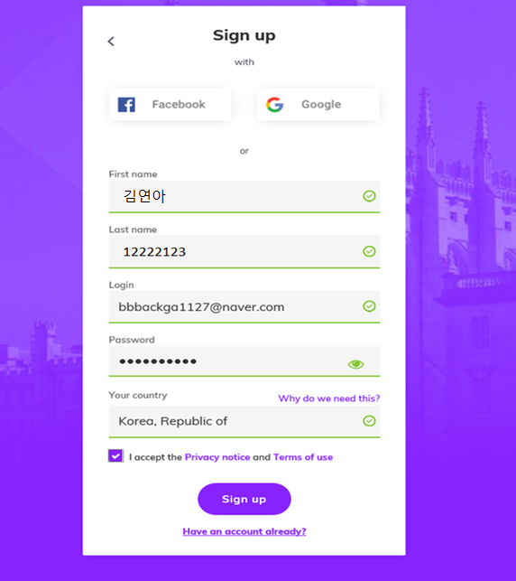
cambridgeone.org
!

Slide 12
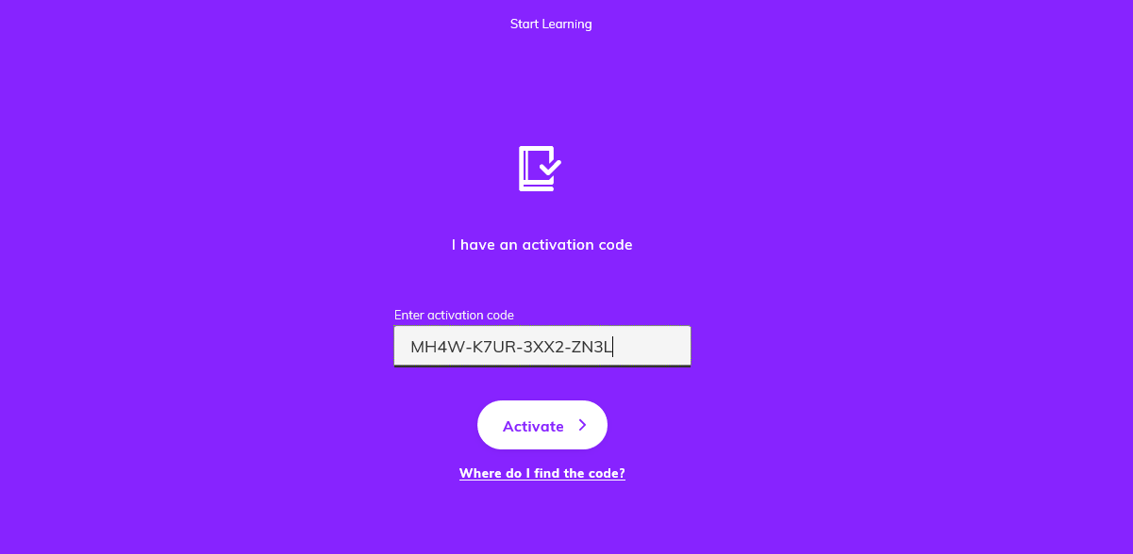
cambridgeone.org
Use the number inside your book.
XXXX-XXXX-XXXX-XXXX

Slide 13
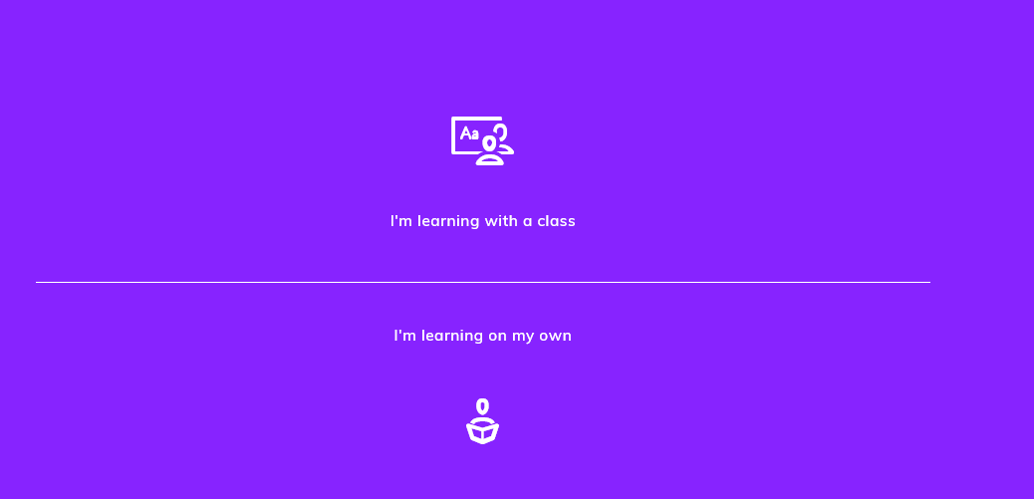
cambridgeone.org

Slide 14
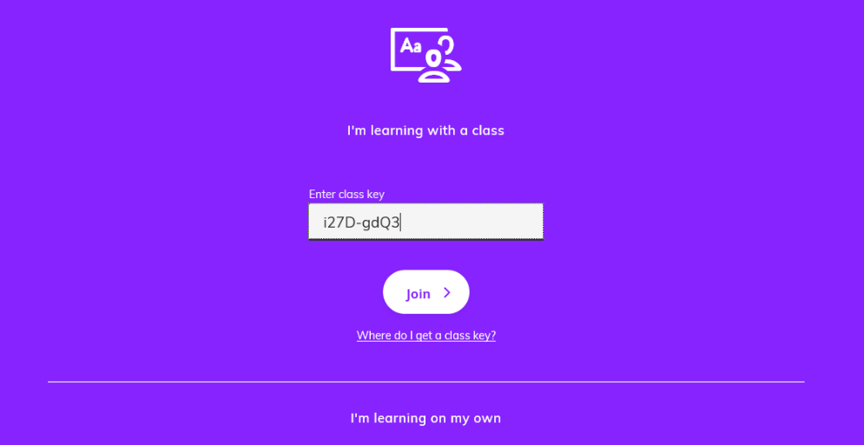
cambridgeone.org
Use the number posted on i-class.
XXXX-XXXX

Slide 15

Midterm Exam – 25%
Week 8 Written Exam
Multiple choice
Fill in the blanks
T/F
Etc.

Slide 16

Final Exam – 25%
Week 15 Speaking Exam
1 prepared answer
1 free-style answer

Slide 17
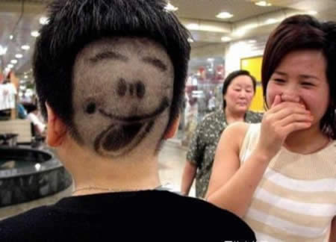
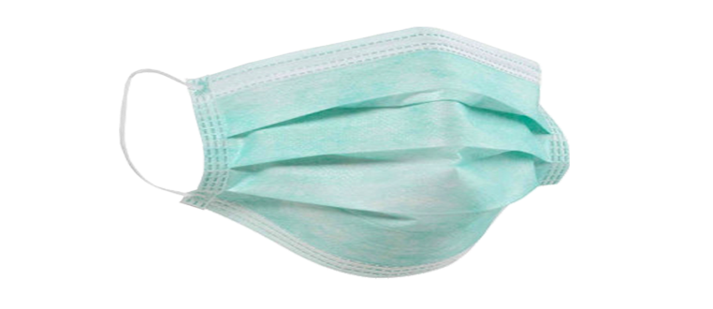
Have fun!
Stay safe!

Slide 18
Questions?
Send me an i-class message.

