Slide 1

Advanced
College
English
(ACE)

Slide 2

Instructor: David Connors
Contact: i-class message
Website: esldocs.com/inha
Office: 1212
60th Anniversary Building
Admin. Office: 1306
Admin. Phone: 032-860-9254

Slide 3

Text:

Slide 4
Grading:
Online
5%
5%
30%
Offline
5%
15%
20%
20%
Attendance
Participation
Online Quizzes
Offline Quizzes
Midterm Exam
Final Exam

Slide 5

Grading:
Maximum allowance:
A
B
C-F
35%
45%
20%
B
> 70%
C
55% -70%
D
< 55%
F
4 absences
* +s and 0s will be used.

Slide 6
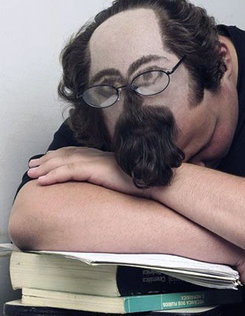
Attendance – 5%
Absent 4 times = F
Excuses: military
covid-19
Other excuse? Talk to me.

Slide 7

Online Participation – 5%
Talk to your online professor.

Slide 8

Online Quizzes – 30%
Talk to your online professor.

Slide 9
Offline Quizzes – 15%
- based on the vocabulary and content from your textbook.
T/F
Multiple Choice
Matching
Don’t miss any quizzes!

Slide 10
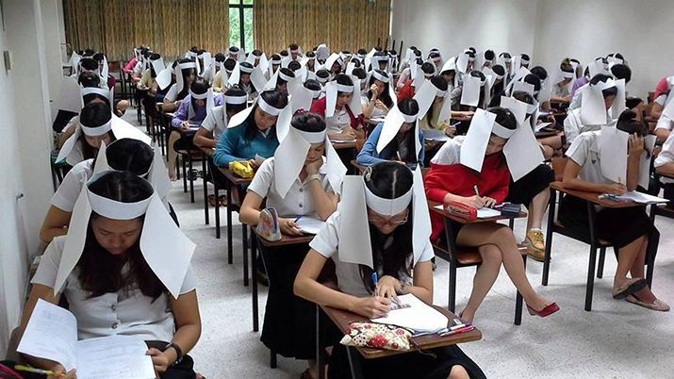
Midterm Exam – 20%
Week 8 – online or in-class exam
Based on book readings and vocabulary.

Slide 11

Final Exam – 20%
Week 15 - online or in-class exam
Based on book readings and vocabulary.

Slide 12


Have fun!
Stay safe!

Slide 13
Questions?
Send me an i-class message.

