Slide 1

English Communication
Intermediate

Slide 2

Instructor: David Connors
E-Mail: gimple@hotmail.com
Website: esldocs.com/inha
Office: 1212
Admin. Office: 1306
Admin. Phone: 032-860-9254

Slide 3

Text:
Unlock 3
Listening & Speaking Skills

Slide 4
Grading:
Attendance 10%
Participation 5%
Homework 10%
Quizzes 25%
Midterm Exam 25%
Final Exam 25%

Slide 5

Grading:
Maximum allowance:
A
B-F
30%
70%
* Subject to change.
B
> 70%
C
55% -70%
D
< 55%
F
8 absences /
missed exam
* +s and 0s will be used.

Slide 6
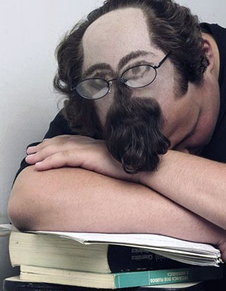
Attendance – 10%
Absent 4 classes = F
Excuses: military
covid-19
* No camera/no mic = absent

Slide 7

Attendance – Video Day
1. Watch the video.
2. Take the quiz on i-class
(missing the quiz = absent)

Slide 8
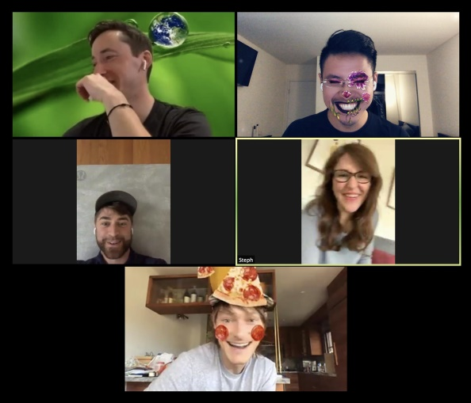
Attendance – Zoom Day
1. Join the Zoom room.
2. Use this format for your name:
Assigned number, Nickname, Korean name
Eg: 1 Don 마동석
2 Grasshopper 유재석
3 전원주
Absent = didn’t join
camera off
sleeping
< 50% of time spent in class

Slide 9

Participation – 5%
1. Time spent in Zoom classes.
2. Speaking English in breakout rooms.
3. Asking or answering questions.
4. Other…

Slide 10

Quizzes – 25%
3 quizzes
Multiple choice,
matching, T or F,
fill in the blank, etc.
(no essays)

Slide 11

Homework – 10%
Online homework:
cambridgelms.org
Progress + Score
(% completion) + (% correct answers)
To register you need:
- A book with an unscratched code.
- A class code.
- To use your STUDENT NUMBER as your USERNAME.

Slide 12
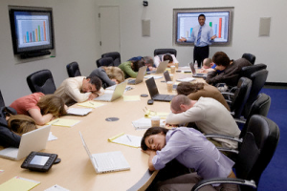
Midterm Exam – 25%
Week 8
Oral
or
Written
Exam

Slide 13

Final Exam – 25%
Week 15
Oral
or
Written
Exam

Slide 14
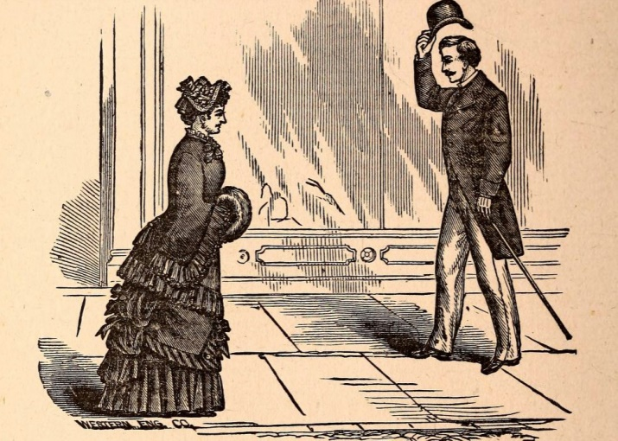
Zoom Etiquette
- Keep your cameras on.
- Speak English in the breakout rooms.
- Turn off your mic if you are in a noisy place.
- Answer questions (even if you are not called).
- Laugh at the teacher’s bad jokes.

Slide 15
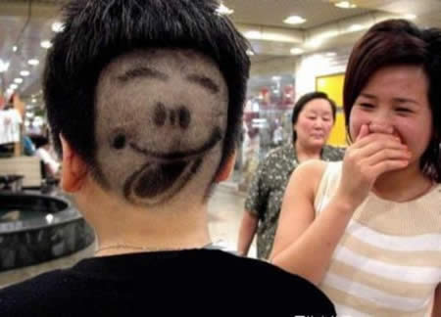
Have fun!

Slide 16
Final note…
If you’re still not vaccinated and don’t have a proper mask, try one of these:

Slide 17
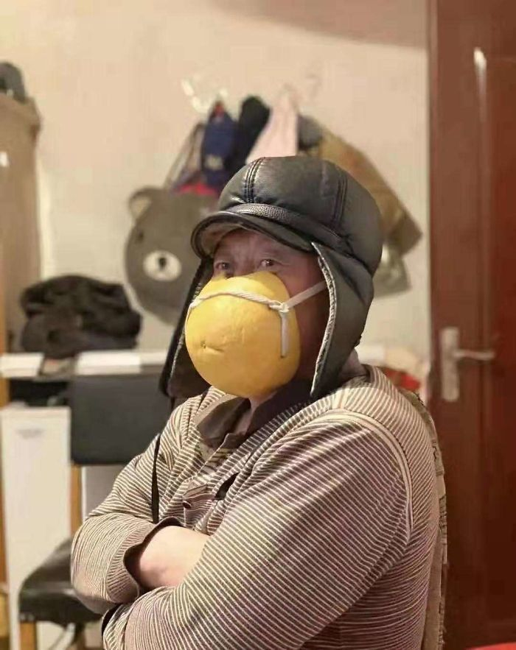

Slide 18
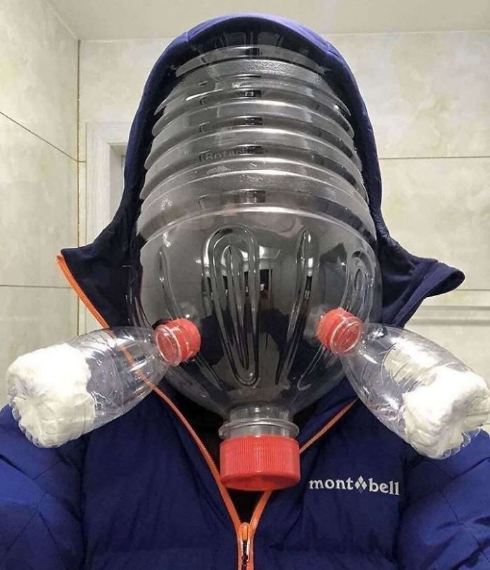

Slide 19
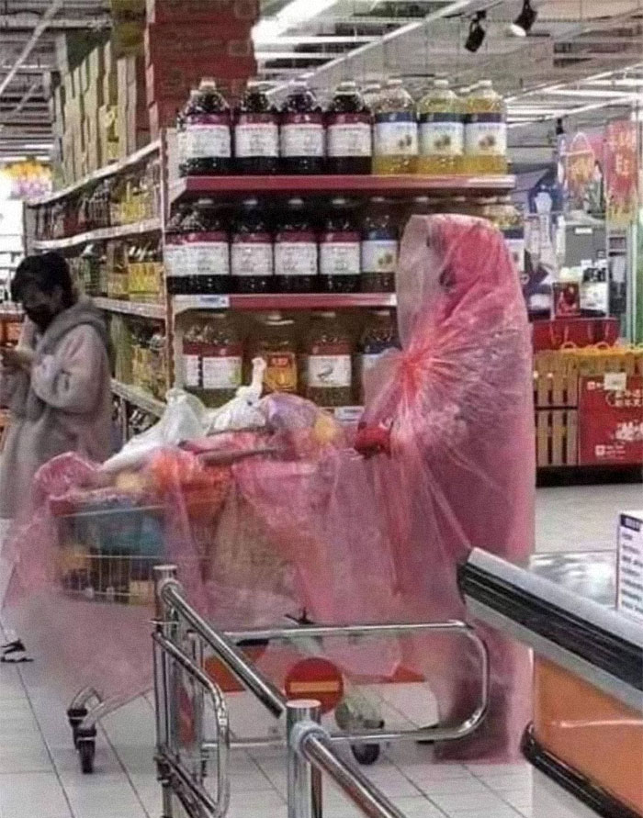

Slide 20
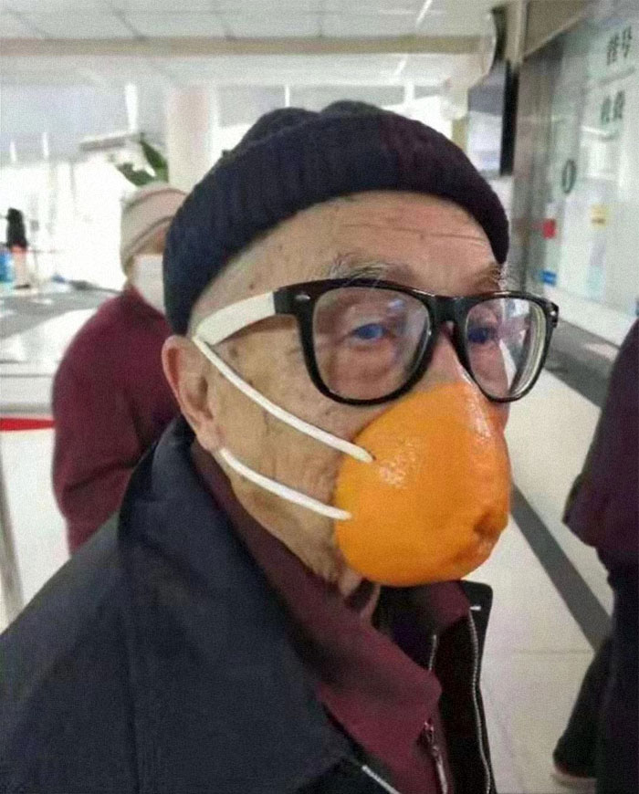

Slide 21
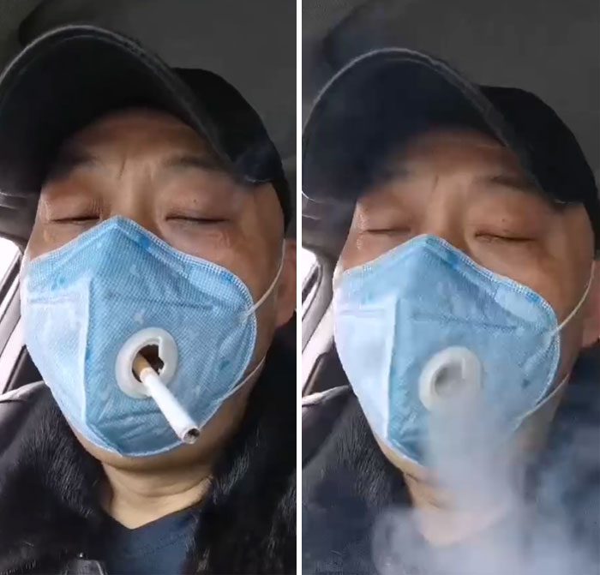

Slide 22
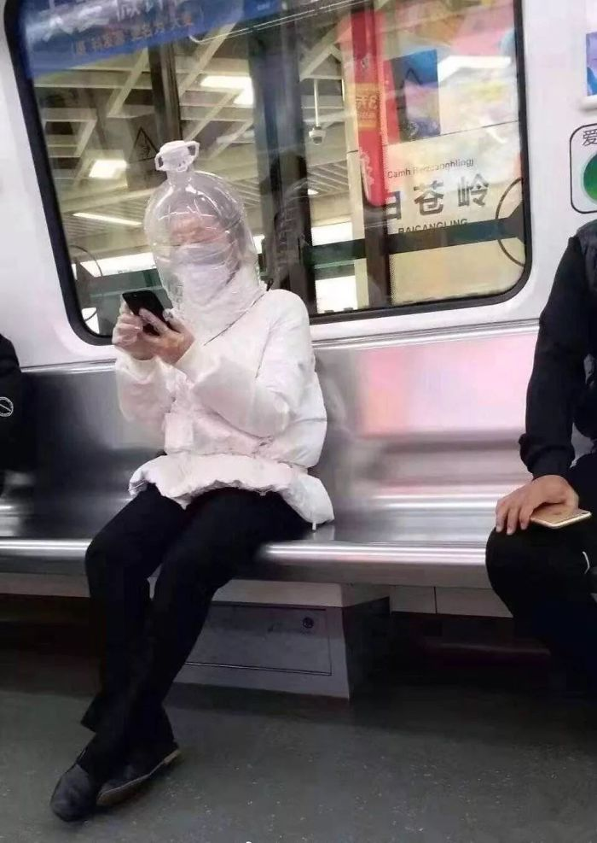

Slide 23
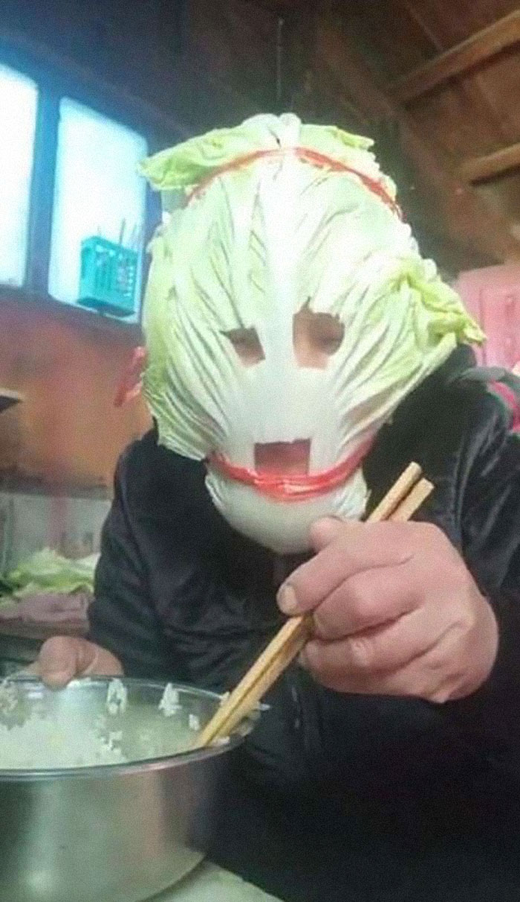

Slide 24
Be safe…

Slide 25
Questions?
gimple@hotmail.com

