Slide 1

English Communication
Advanced

Slide 2

Instructor: David Connors
E-Mail: gimple@hotmail.com
Office: 1212

Slide 3

Text:
Unlock 4
Listening & Speaking Skills

Slide 4
Grading:
Attendance 10%
Participation (and other) 10%
Quizzes (and other) 30%
Midterm Exam 25%
Final Exam 25%

Slide 5

Grading:
A
B
C,
D,F
35%
45%
20%

Slide 6
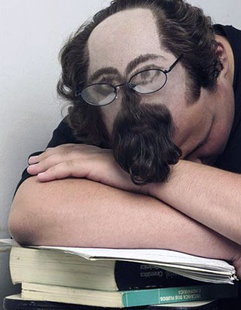
Attendance – 10%
Absent 4 classes = F
Excuses: military
3 times late = -1
Sleeping in class = -1
1 class is free!!!

Slide 7

Quizzes – 30%
3 quizzes
Multiple choice,
matching, T or F,
fill in the blank, etc.
(no essays)

Slide 8

Participation – 10%
Paper Homework
+
Online Homework
+
in class participation
+
Answering questions
Talking with your partner
Doing book work
-
No book
Using Kakao
Silent

Slide 9
Online Homework
www.cambridgelms.org
Your grade includes:
Progress + Score
(% completion) + (% correct answers)
Register your username as your student number with an “a” in front. Eg: a12181234
Class code: zA9pW3
z

Slide 10
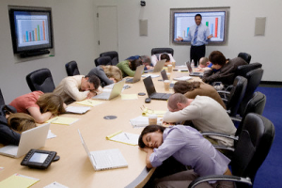
Midterm Exam – 25%
Group discussion.

Slide 11

Final Exam – 25%
Speaking test.
5 minutes.
Based on language
from the textbook.

Slide 12
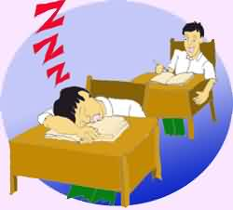

Rules:
No sleeping.
No texting. ☹

Slide 13
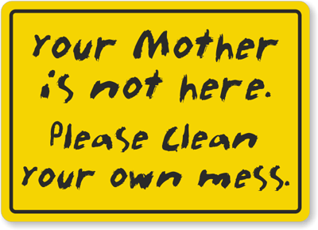
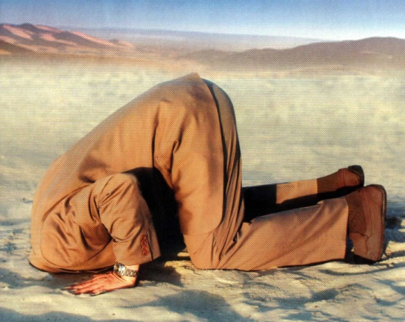
Rules:
Having a drink
or snack is OK,
but please clean up your trash.
Don’t be silent!
Practice makes perfect.

Slide 14
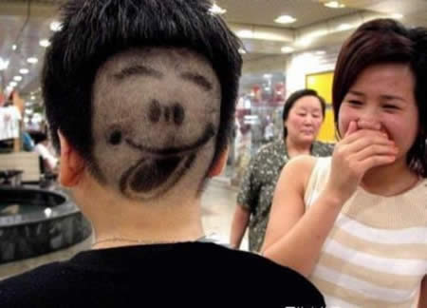
Have fun!

Slide 15
Calendar
Monday | Tuesday | Wednesday | Thursday | Friday
24 Intros Unit 1 | 25 CHRISTMAS | 26 Unit 1 | 27 Unit 2 | 28 HW#1 due Unit 2
31 Unit 9 Quiz 1: Units 1 & 2 | 1 NEW YEAR | 2 Unit 9 | 3 Unit 3 | 4 HW#2-3 due Unit 3
7 Unit 4 Quiz 2: Units 9 & 3 | 8 Mid-term Exam | 9 Unit 4 | 10 Unit 7 | 11 HW#4-5 & Online HW due Unit 7
14 Quiz 3: Units 4 & 7 | 15 Final Speaking Exam
M 20: Unit 1
T 21: Unit 1
W 22: HW#1 due
Th 23: Christmas
F 24:
M 27: Quiz 1
T 28:
W 29:
Th 30: New Year
F 1: Quiz 2
M 4: Mid Term / HW#2 due
T 5:
W 6:
Th 7: Quiz 3
F 8:
M 11: Quiz 4
T 12: Final Exam
W 13: Questions & Concerns

